Slide 1
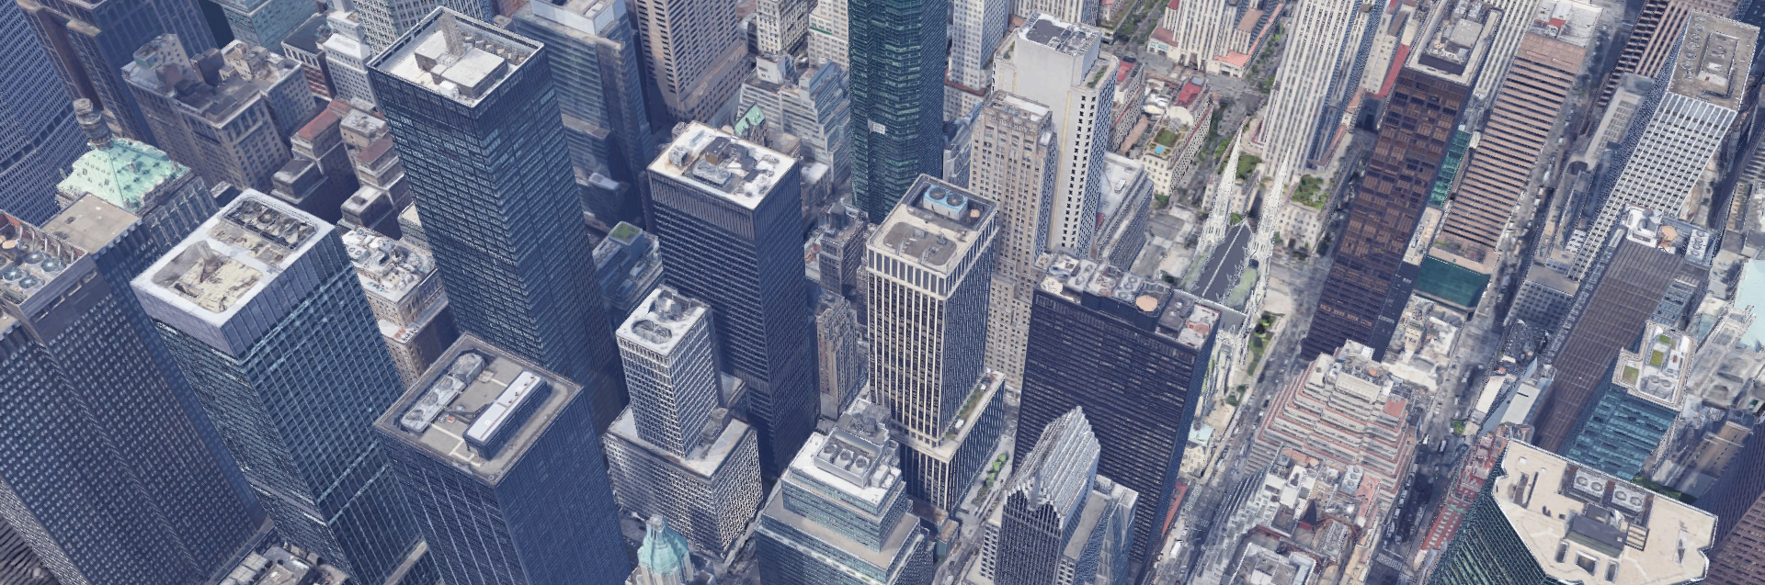
AWE Cooling Technology Study
Imagery @2019 Google
AWE Cooling Technology Study
Notes:
New York City via Google Maps

Slide 2
AWE: A Voice for Water Efficiency
Our mission is to promote an efficient and sustainable water future
Over 530+ member organizations in 200 watersheds delivering water to 50 million water users

Slide 3
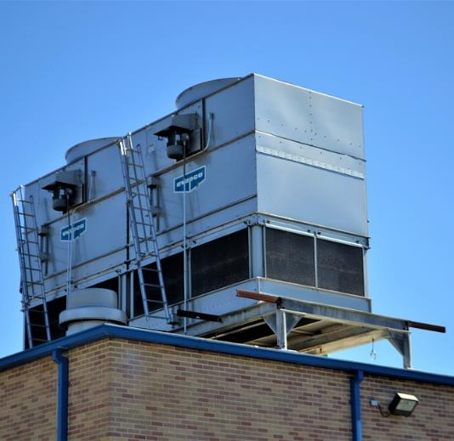
What is a Cooling Tower?
Key component of cooling systems
For example:
Cooling towers recirculate water to remove heat from air conditioning equipment in buildings
Heat is rejected from the building via evaporation into the atmosphere
Also used for cooling related to various industrial processes
Imagery @2019 Google
Image: U.S. Department of Energy
Imagery @2019 Google

Slide 4
Where are Cooling Towers Used?
Examples:
Office Buildings
Large Multifamily Buildings
Schools
Hospitals
Resorts and Large Hotels
Data Centers
Airports
Industrial and Manufacturing Facilities

Slide 5
Why is this Project Important?
Cooling towers are unfamiliar to most people
Difficult to understand the scope of cooling towers in a water provider service area
How many?
Cooling load?
Water use?
Where are they located?
Difficult to design effective water efficiency programs
Lack of resources and tools
A lot of opportunity for water savings

Slide 6
Project Team
Research Team
Pacific Northwest National Laboratory
Project Managers and Advisors
Maureen Erbeznik & Associates
Alliance for Water Efficiency
Project Advisory Committee
Funders
H.W. Hoffman & Associates

Slide 7
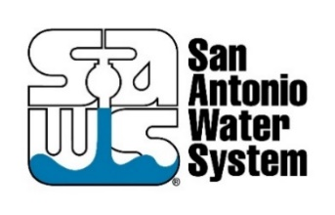
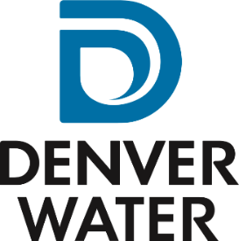
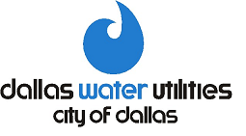
Metropolitan Water District of Southern California, California, United States
Southern Nevada Water Authority, Nevada, United States
San Antonio Water System, Texas, United States
California Water Service, California, United States
City of Guelph, Ontario, Canada
Denver Water, Colorado, United States
Austin Water, Texas, United States
City of Dallas, Texas, United States
City of Tucson, Arizona, United States
City of Santa Fe, New Mexico, United States
Santa Clara Valley Water District, California, United States
City of Calgary, Alberta, Canada
East Bay Municipal Utility District, California, United States
SCV Water, California, United States
Western Municipal Water District, California, United States
Municipal Water District of Orange County, California, United States
Los Angeles Department of Water and Power, California
Commonwealth Edison, Illinois, United States

Slide 8
Five Main Objectives
Develop best practices for identifying water-cooled facilities in urban areas.
Develop best practices for estimating consumptive and non-consumptive water demands for cooling.
Determine the conservation potential for improvements to traditional cooling technologies such as cooling towers.
Determine the conservation potential of alternative cooling technologies.
Develop practical guides, incorporating study results, to increase the effectiveness of cooling water use efficiency incentive and outreach programs.

Slide 9
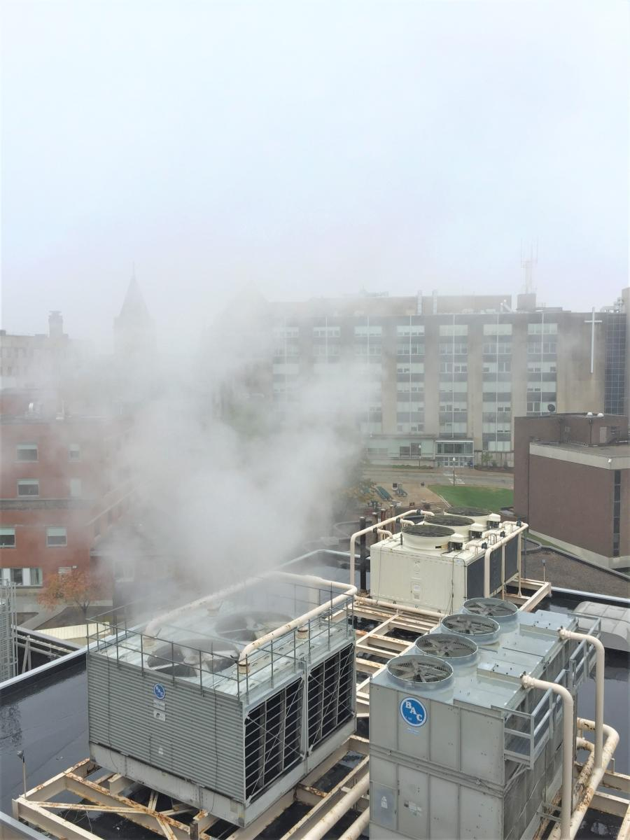
Project Resources
Cooling Tower Estimating Model
Water Quality Helper
Alternative Cooling Technology Report and Market Model
Forthcoming Program Design and Outreach Materials

Slide 13
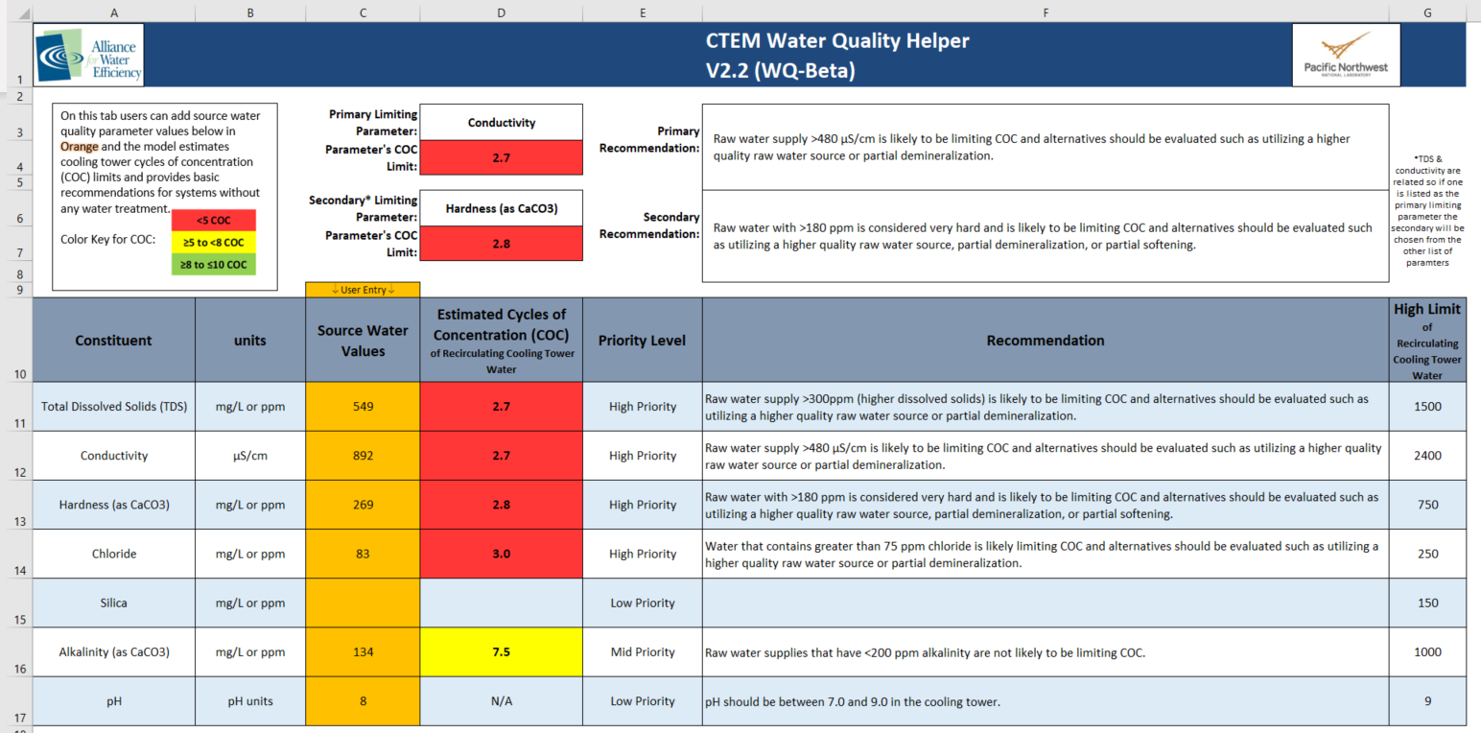
Water Quality Helper

Slide 14
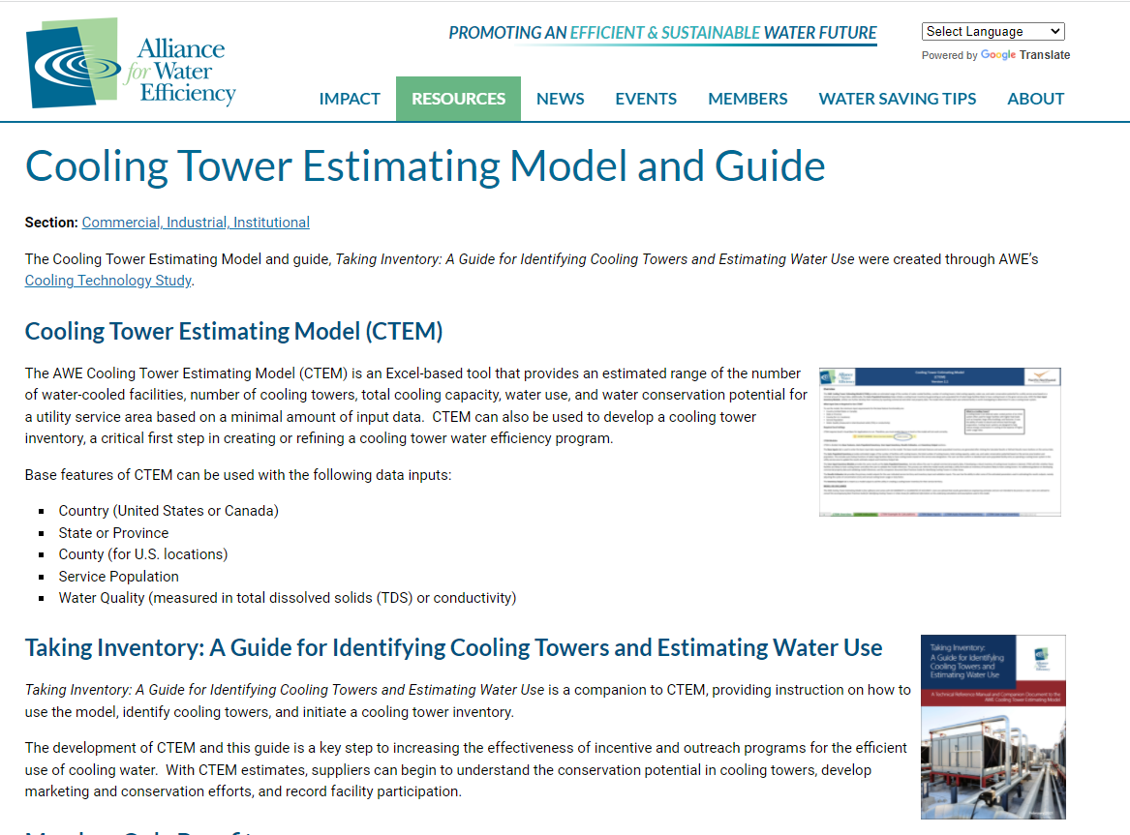
How Do I Get a Copy of CTEM???
Available free for AWE Members
Visit: https://www.allianceforwaterefficiency.org/resources/topic/ctem
Webinar held April 14, 2021
https://www.youtube.com/watch?v=8LtXZ3-NdSc

Slide 15
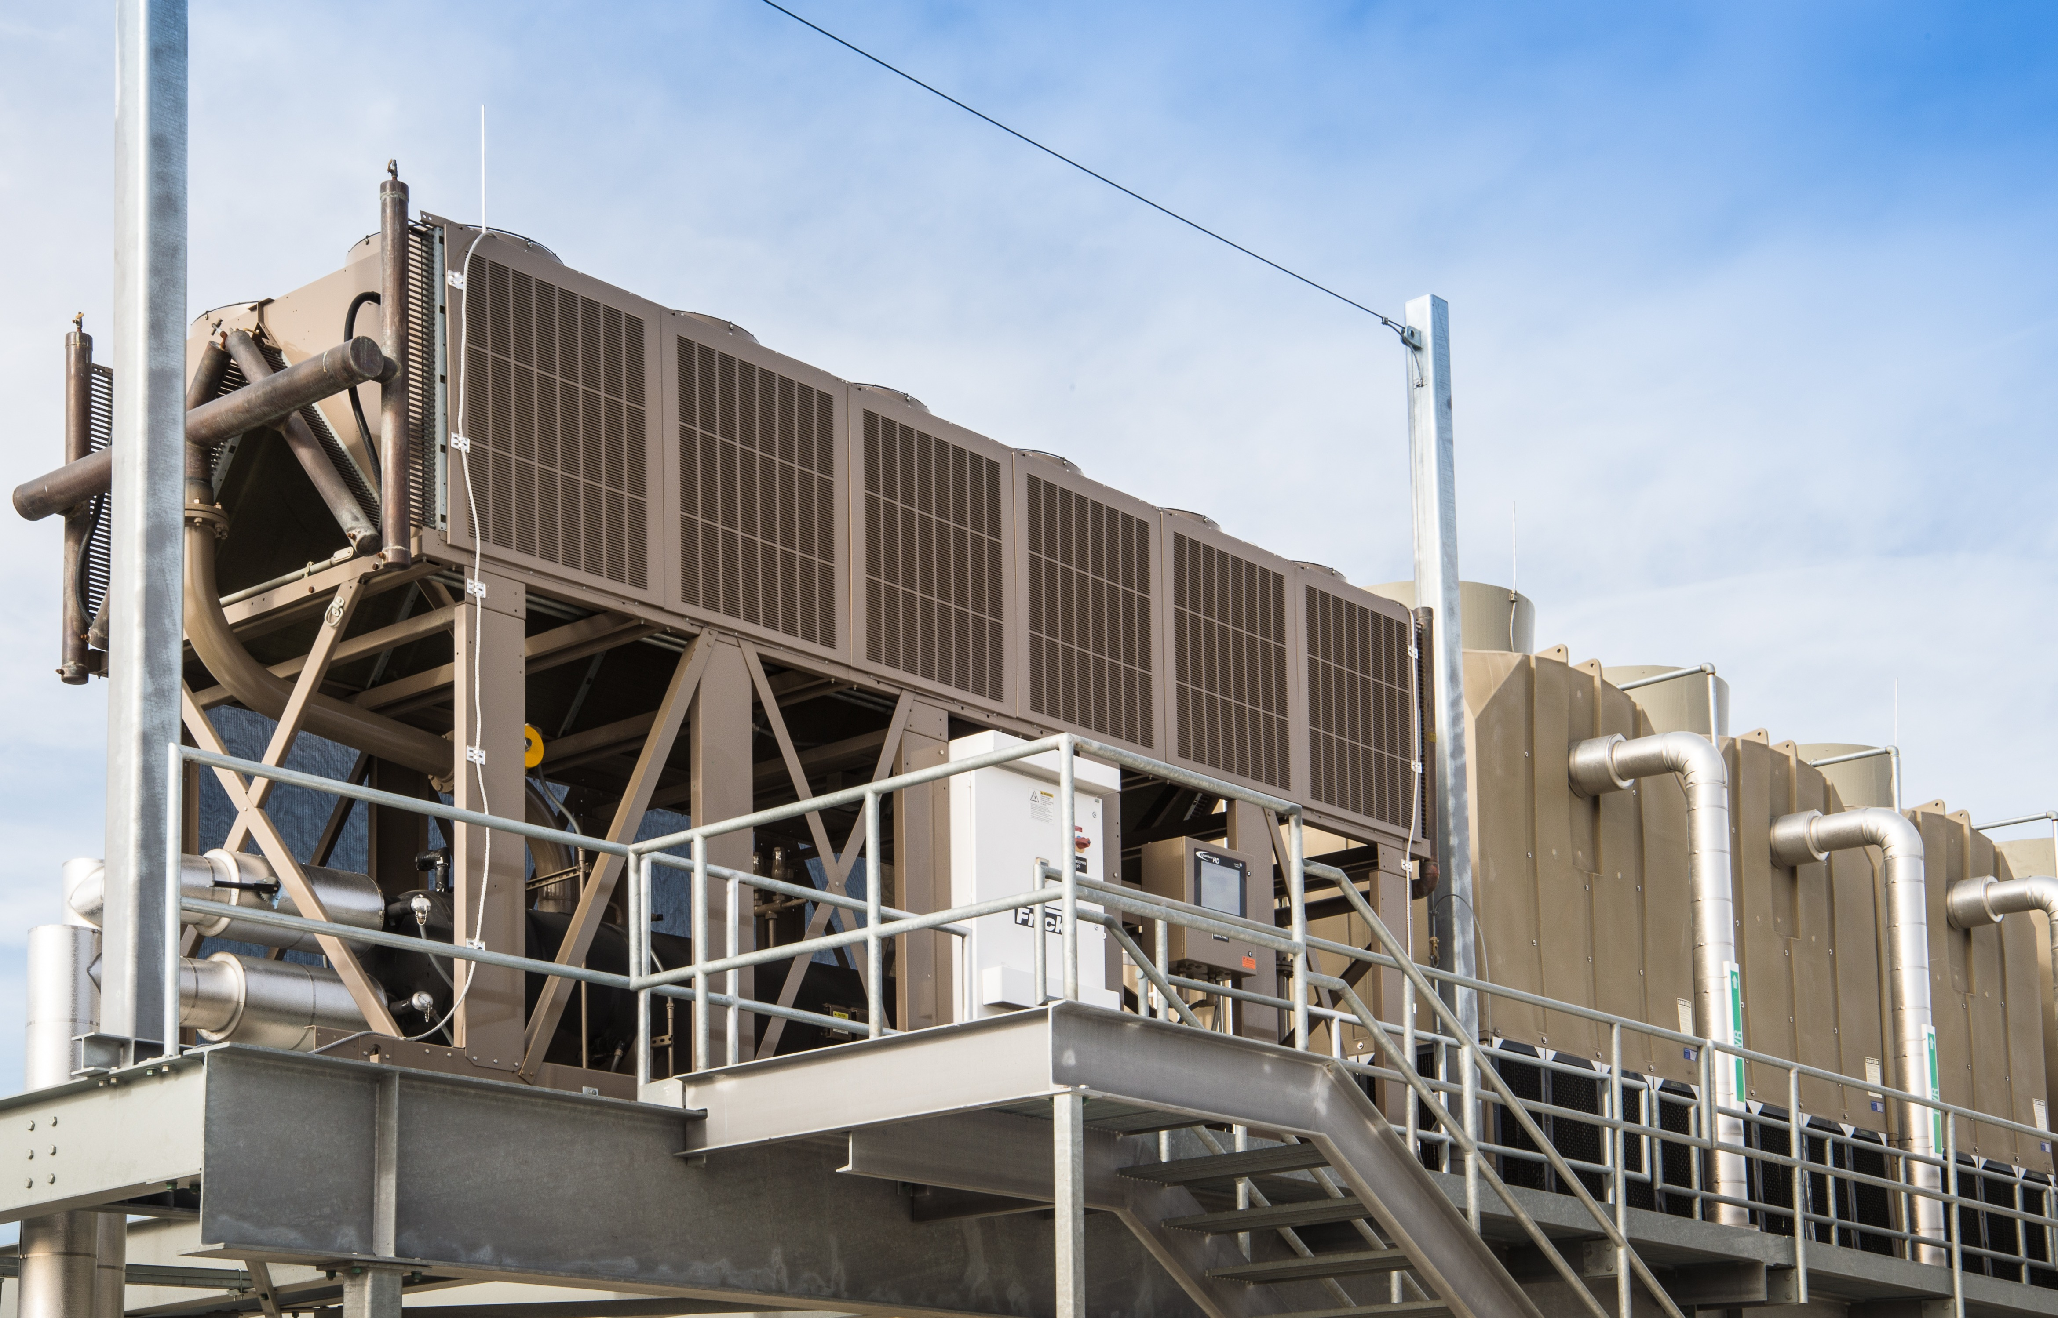
Alternative Cooling Technology
Adiabatic Cooling
Salt-Based Ion Exchange Systems
Water Recapture Systems

Slide 16
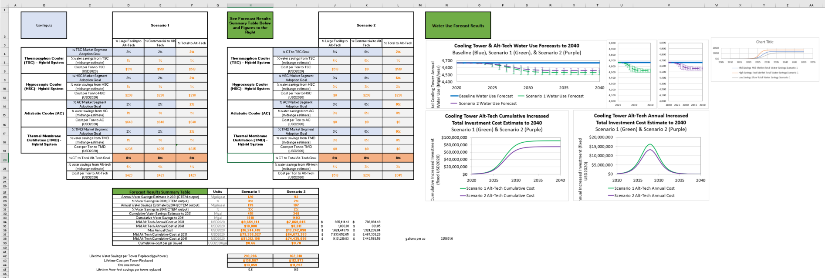
Alternative Cooling Technology - Resources
Report
Market Penetration Model - to assess the uptake of alternative cooling technologies
ComED commissioned

Slide 17
Next Steps
Moving Forward with the Final Deliverables, to be released by Spring of 2022:
A Final Report
"How To" guide on setting up a cooling tower water efficiency program
Summary of cooling tower water efficiency strategies and how to select what is optimal for a given service area based on water quality and climate
Cooling tower audit assessment form (tool for assessing individual cooling towers)
Email templates to connect with different people in the industry for outreach and follow up
A return-on-investment calculator to evaluate efficiency improvements for individual towers

Slide 18
Questions?
Stay Connected to Access Cooling Technology Resources!
As previously mentioned many of these informative cooling tower project deliverables are still to be released
If you are interested here are some ways to stay up to date
Join AWE!
Check our website, emails, and social media
Directly email me (below)
Brad Spilka Program Planner
Alliance for Water Efficiency
brad@a4we.org
773-360-5100
Maureen Erbeznik Principal
Maureen Erbeznik and Associates
merbeznik58@gmail.com

