Slide 1
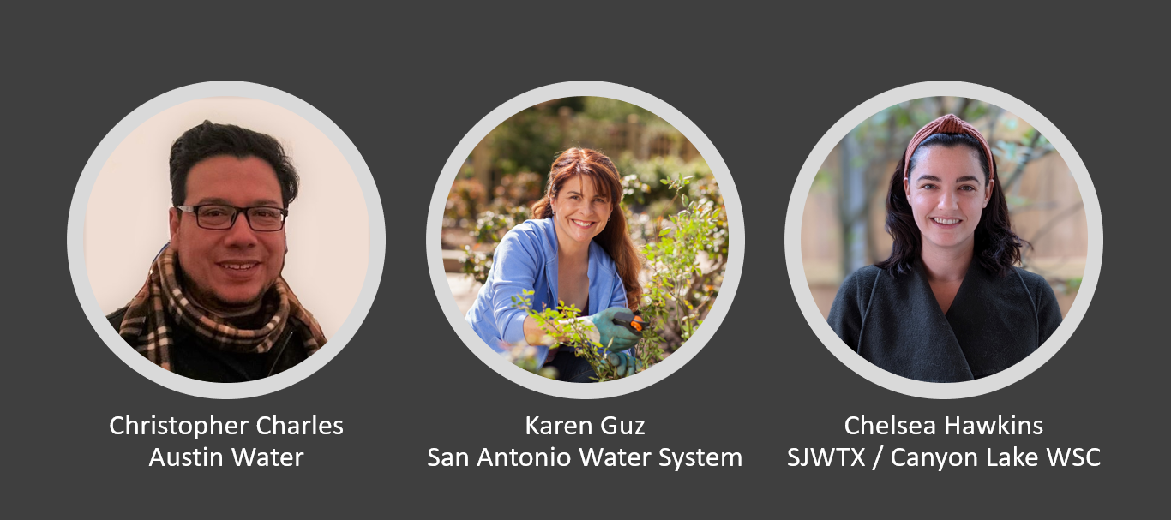
Customer Engagement Panel

Slide 2
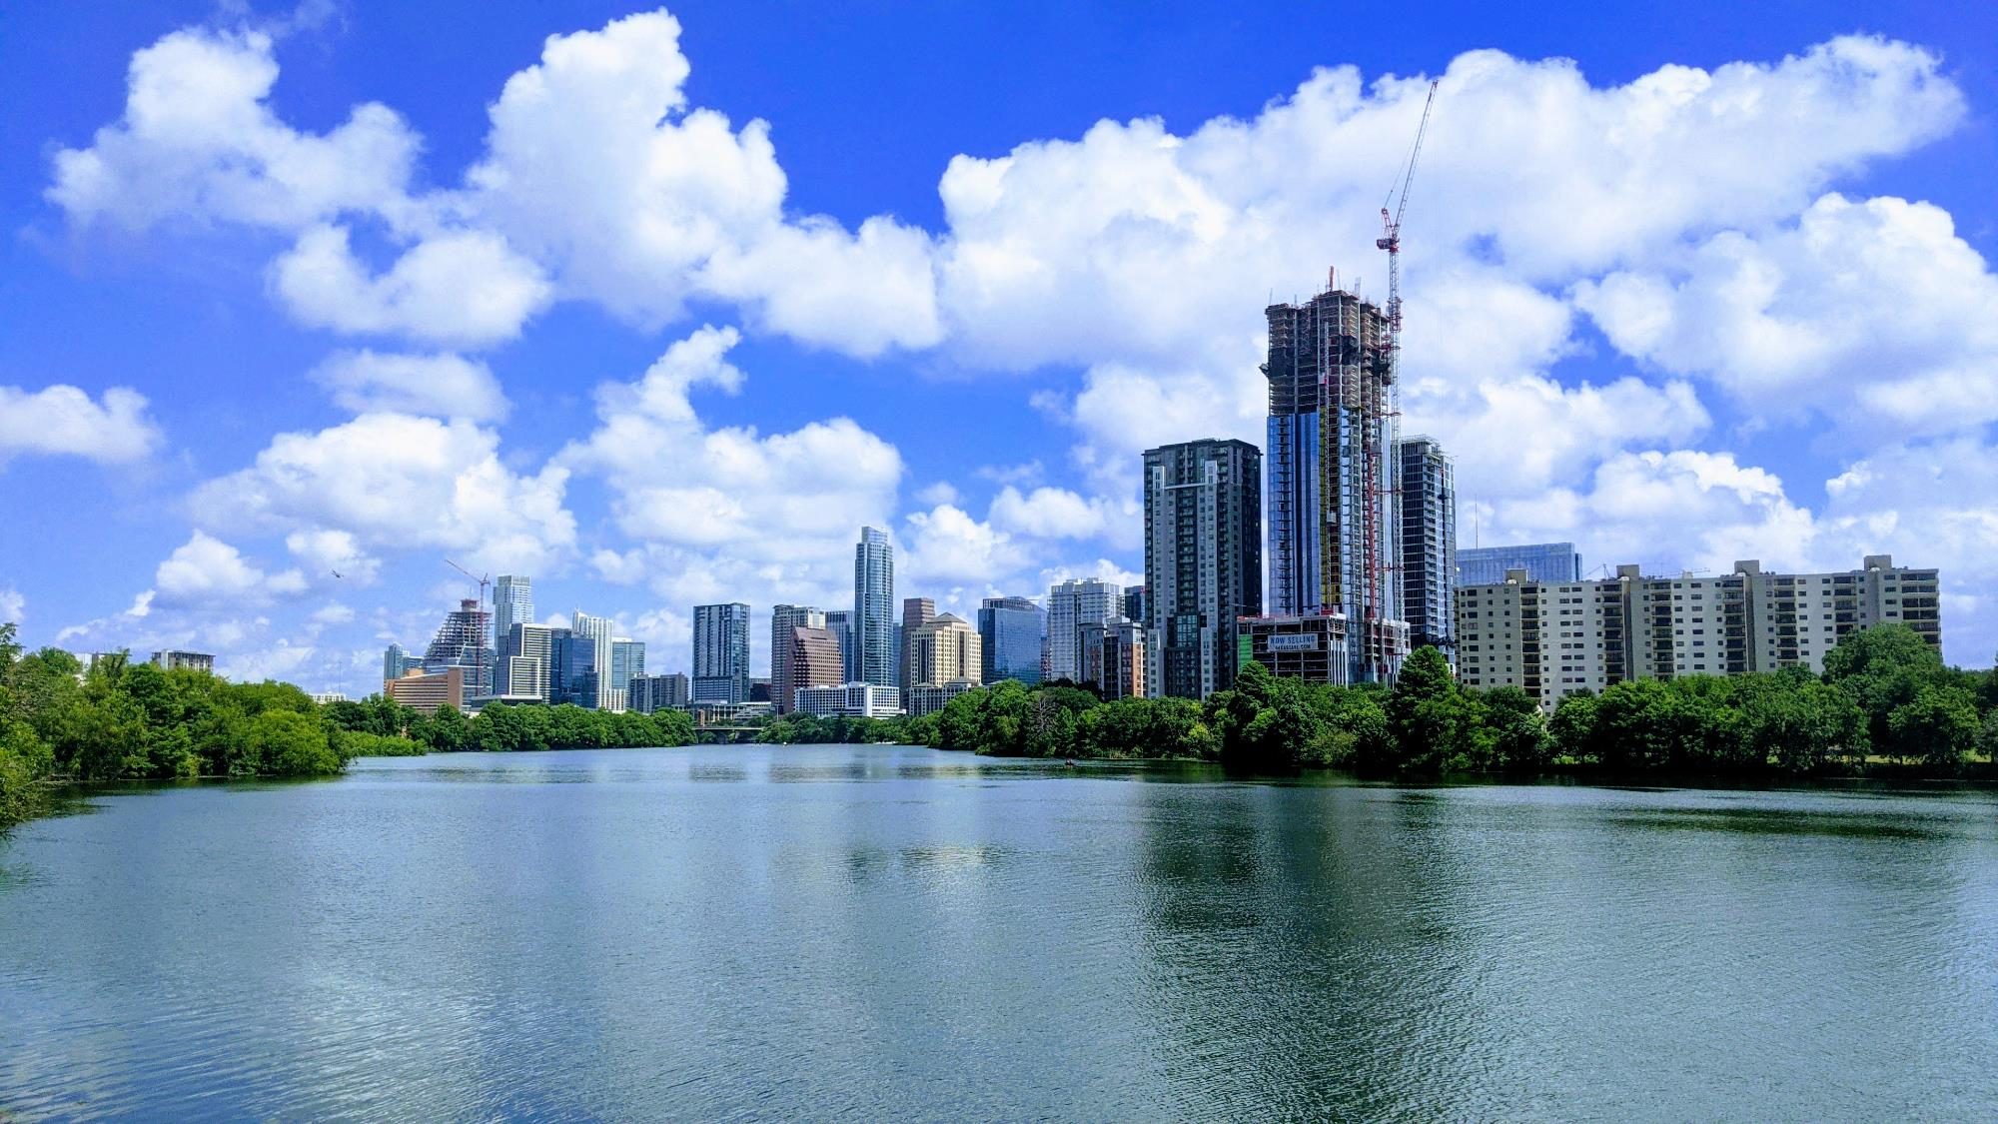
Where are the applications?
Changing Characteristics of Rebate Program Participants in Austin over 10-years
Christopher Charles
Conservation Program Specialists
February 15, 2022
Notes:
I run the outdoor landscape rebate programs at the Austin Water – Water Conservation Division for 10 years now.
My education is in Environmental Science and Landscape Architecture.

Slide 3
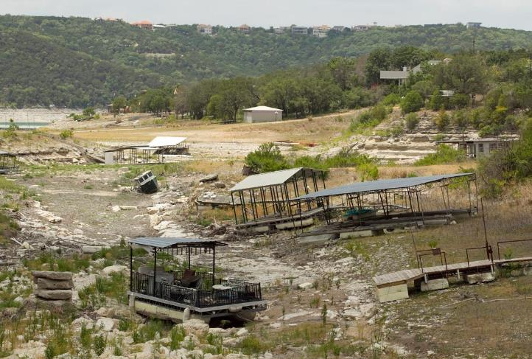
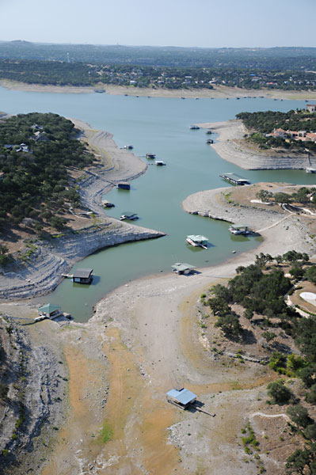
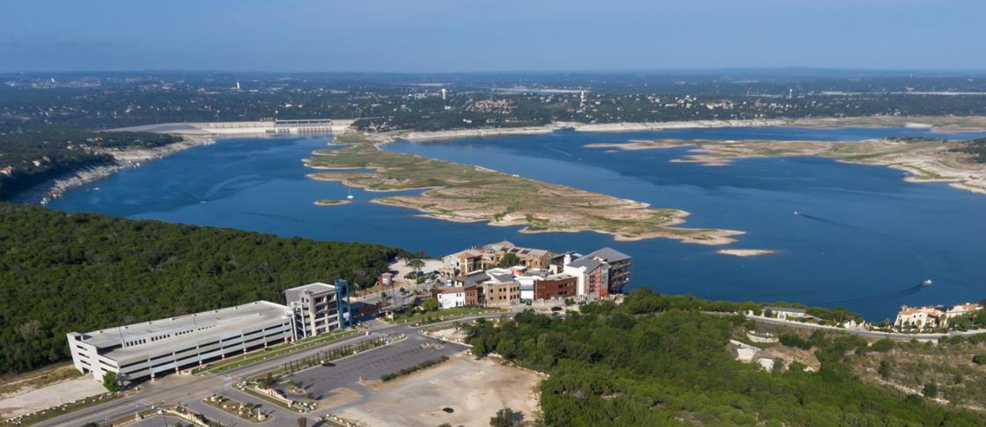
Drought of 2011-2016
Notes:
Austin’s water supply comes from a combined storage of Lake Travis and Lake Buchanan. I believe all of us were affected one way or another during this time.

Slide 4
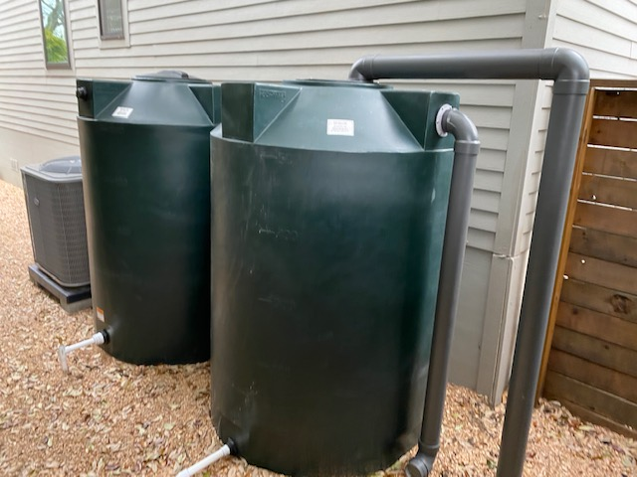
Studied Rebate Programs
The Rainwater Harvesting Program
  $.50/gallon for gravity release tanks
  $1.00/gallon for pressurized systems
    RPZ Requirement
    Even if not connected to city supply line
Notes:
No major changes since 2011. (Most popular rebate of all rebates)

Slide 5
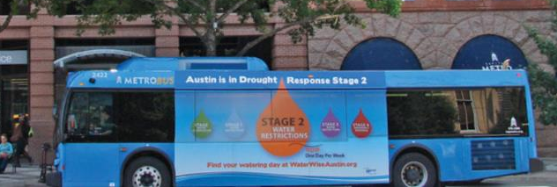
Marketing Efforts
Media Blasts
  Radio
  TV
  Internet (social media, adverts, etc.)
Signs and Publications
  Neighborhood Newsletters
  City Newsletters and Bill Inserts
  City Wide Newspapers
  Bus Wraps
Notes:
So how did we promote these programs during this 10-year period? Not blasting internet until 2017 but platforms like NextDoor gave us more opportunities to reach out.

Slide 6
Rainfall and Applications
Total FY Rainfall (inches)
Number of Total Applications for both programs
Notes:
DEFINE FISCAL YEAR. (all timeline graphs in this presentation) Average rainfall for Austin is around 34 inches a year. (NOAA for these numbers) We are looking at the combined RWH and WWL application submittals. This includes denied applications for those that did not meet application requirements.

Slide 7
Marketing Expenditures and Applications
Number of Applications
Notes:
Cannot get more granular than yearly budgets

Slide 8
Lake levels and Applications
Acre
Feet
Number of Applications
Notes:
Inverse relationship. Closest

Slide 9
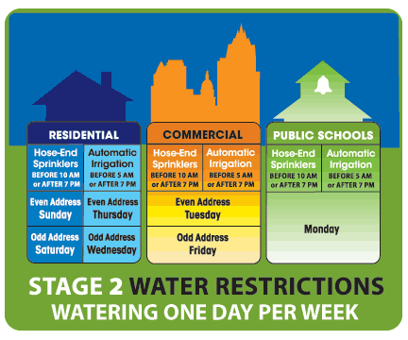
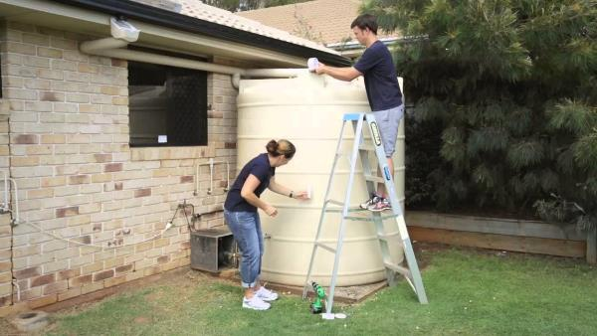
Other Possible Factors
“Drought Stages” fear increased participation
We have reached everybody who is interested/has the resources
Rebate amount too small considering:
  Time
  Money
  Requirements
Notes:
That would have needed a behavioral study to confirm.
When hearing Stage 2 restrictions, ears perk up.(what happens during these stages?)
And why did they have the resources in 2011?

Slide 10
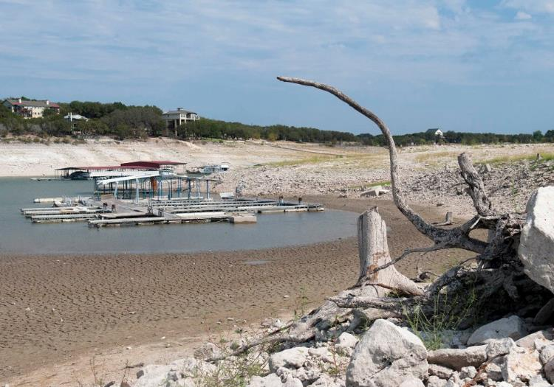
In Conclusion
Rainfall had little effect on application submittals
Marketing expenditures were closely related to application submittals but does not explain 2016 decrease
Lake levels showed closest relation to application submittals
  Customers are not concerned about conservation when levels are normal
Notes:
Again, these are application submittals, not participants. .. Rainfall had “little” effect on applications..

Slide 11
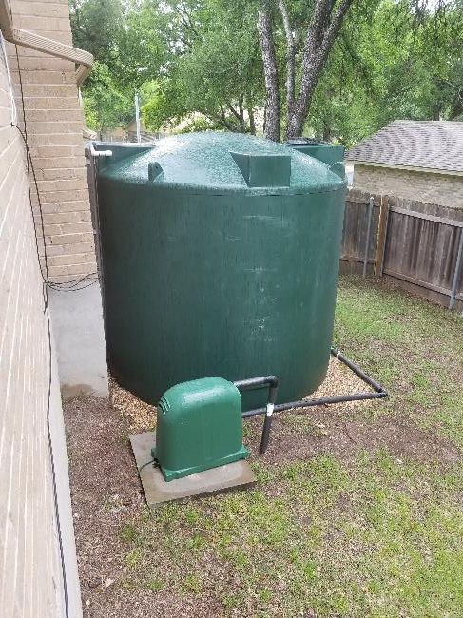
Moving Forward
Revisions to Rebates
  Increase rebate amounts
  Targeted outreach
  Create new rebates (Let old ones die)
Lake level graphics on:
    Water Conservation Rebates webpage
    Water Smart App Notifications
Create Residential Landscape Ordinances
  Reducing turf grass amounts from the get-go.
Notes:
We are currently looking at these options.
Show where our water supply should be instead of highlighting the drought levels. WaterSmart app notifications. (My ATX Water)
Or should we concentrate our efforts in residential landscape ordinances.
Thank you and now I will hand it over to Karen.

Slide 12
Thank you
Christopher Charles
Conservation Program Specialist
City of Austin | Austin Water, Water Conservation
512-972-0366
Christopher.Charles@austintexas.gov

Slide 13
Customer Engagement Panel

Slide 15
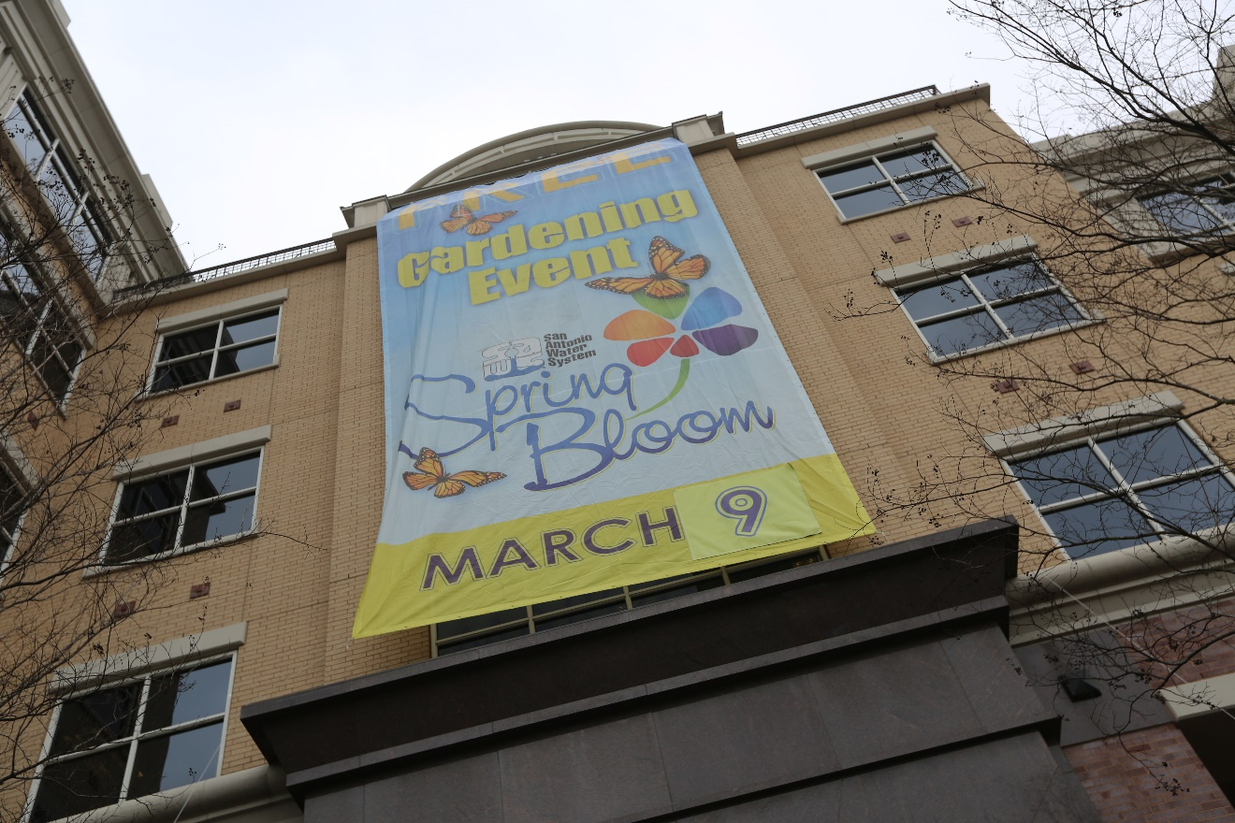
Not All Programs Are Huge…Should They Be?
Targeted Programs
Niche Programs
Applications..Not Completed?
Works..If We Push to You
Normal Fluctuation Program
Program Fails

Slide 16
Program Fail
Now What?
Drop it and back to drawing board!
New Focus:
Require irrigation eliminated
Coupon for reasonable area to change is more popular
GardenStyleSA.com education
  Reassurance lots of water NOT needed for all pretty plants
Let’s Face It…This Bombed
Example:
Original SAWS Landscape Rebate
Why Fail:
Very low participation
Net zero savings due to some increasing usage & others no change
Irrigation still there & people water “pretty” plants

Slide 17
Niche Programs
Yes! Do Marketing
Market to those pre-qualified or those specifically targeted
Examples:
PTP: Offer help to qualified when usage spikes
SC: Push coupon out ONLY to single family super users
BRD: Send offer ONLY to qualified, elderly, disabled customers identified for help
Not for “everyone” for a reason
Plumbers to People (PTP)
Smart Controller Residential (SC)
Be Ready Direct (BRD)
  free winterizing plumbing for vulnerable customers

Slide 18
Direct to Customer Marketing Keys
Spend the most time making it REALLY easy to say YES
Make offer in 1st sentence
Keep it scan-read short
You are pre-qualified
Make yes REALLY easy
  Email: click big link in middle
  Letter:
    easy URL to visit web or survey
    Phone number with record option
Web application must be EASY….test for glitches & fix
Other Tips & Tricks
Deadline…limited time offer
Use their name…personal
Include data…summer bill was ___
Consider related color photo
Utility envelopes opened more
Utility logo…yes it’s trustworthy
Re-send again within timeline

Slide 19
Applications…But Not Finishing
What is the problem exactly? Let’s Revise & Try Again
Example: Patioscape Coupons
Coupon is discount on very expensive project
Limited to patios; no deck option
Lots of labor required
Limited vendors take coupon
Lack of customer knowledge on how to install
Outdoor Living Rebate
Coupon vendors too limited
Rebate allows deck option
If more rigorous application process could try higher incentive
More “how to” for DIY
Key will be fraud elimination process

Slide 20
Works….But Only If We Push It
Examples: Commercial Programs like Custom Rebates & Commercial Irrigation Rebates
Big drop off with COVID
Always have had to approach businesses about custom rebates
Smart Controller Commercial rebate process complex/time consuming
Custom Rebate
What are we pushing this year? Ex. Car wash retrofits?
  Work with vendors, stakeholders
  Knock on doors of customers
  Move to another option next year
New Smart Controller Option
Use early custom rebate data
Simplify to “menu” option
Push to those most likely to benefit

Slide 21
How Much Variable Applications Is Normal?
Weather Variable Programs:
Irrigation Consultation
Landscape Transformation Incentives
What to do?
Pick out the super users based on recent bills coming in
Consider a modest, temporary program change
  Create a “special offer” for this summer
Marketing To Super Users
Lead with Personal OMG Data
Ex. Your summer use was x gallons & more than double similar homes.
Note: Have reasonable expectations
Responses will be lower when it is cooler or there is frequent rain.
Marketing only helps so much when grass is naturally green or irrigation is not needed.

Slide 23
Customer Engagement Panel

Slide 24
If/Then
Using AMI Data to Start Customer Conversations
Chelsea Hawkins, J.D., M.S.
Compliance Manager

Slide 25
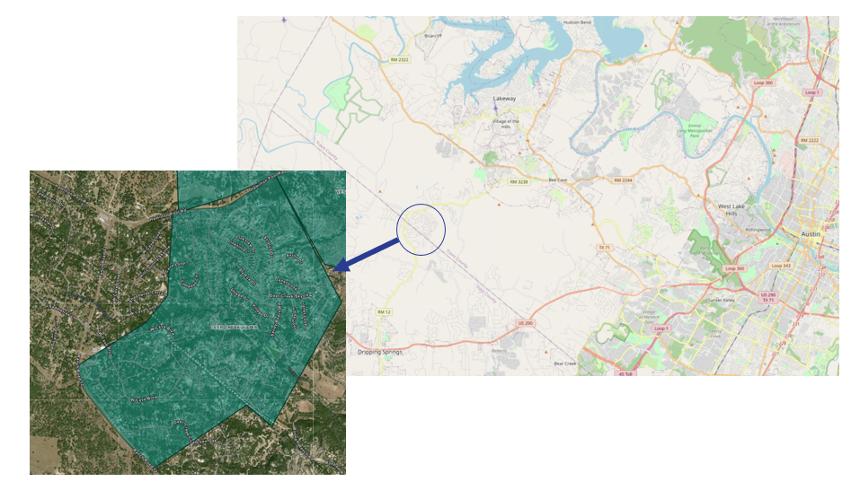
Deer Creek
883 Connections
100% Residential
Est. pop. 2,649
1.86 sq. miles
Hays & Travis Counties
Notes:
-abt 810 connections in 2018

Slide 26
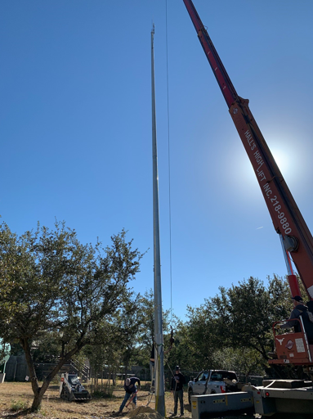
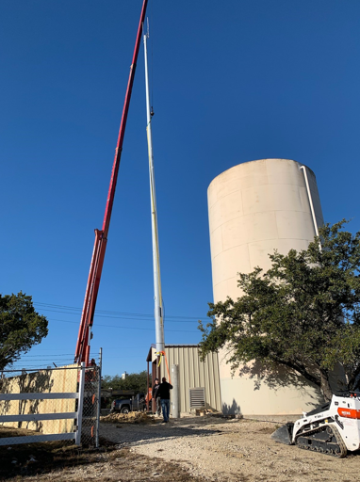
The AMI Journey
Deer Creek Acquired
June 2018
LCRA Grant Application December 2020
Monopoles etc.
March 2021
Neptune 360
March 2021
Meters Replaced
March 2019
WaterSmart & TWRI
Q3 2022
Feasibility & Topo Studies
March-Nov. 2020
Monopole Installation at Linkhill Site
Monopole Installation at Panorama Site
Notes:
-replaced all meters with Neptune with the intention of going to AMI
-applied for grant to help with the Neptune 360 portion
-received grant approval end of 2020/paperwork finished early 2021
-March 2021 was the go-live for AMI

Slide 27

Data + Customers = Success!
Notice to highest users
Discussion about usage with personalized data available
Alignment with conservation programs
One call resolution
  More efficient use of staff time
Leaks
  Advanced leak detection
  Weekly leak notifications to customers
  Updated leak adjustment methodology
Notes:
463 email notifications

Slide 28
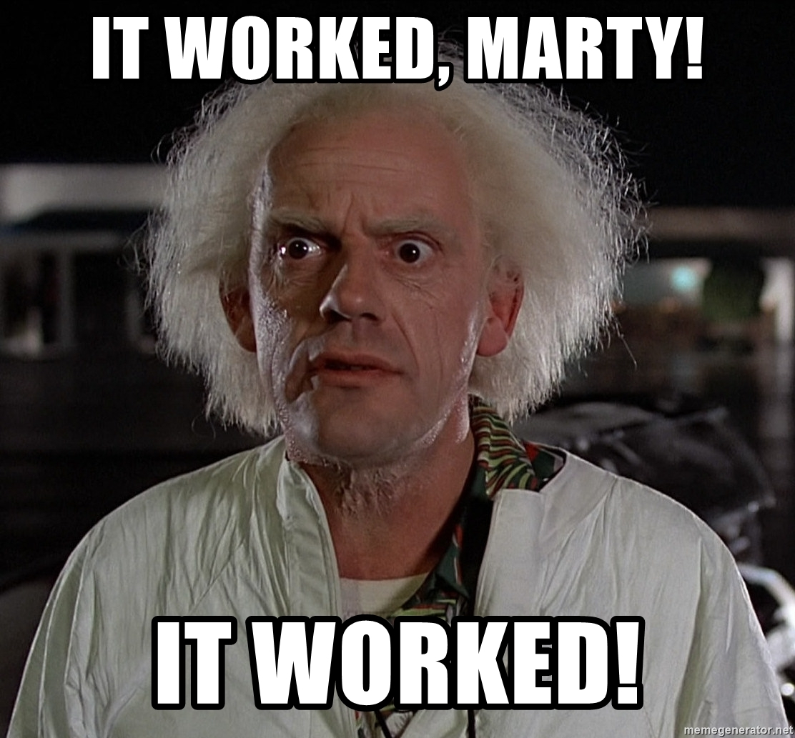
Water Savings
High Use Period (Apr. – Oct.)
  Monthly average per account ↓ by 16.2%
  System use ↓ by 13%
  System growth ↑ 2.3%
  Overall decline in both purchased water and billed usage since implementation
Notes:
For the period of Apr. – Oct. 2021 (was a wetter year)
16.26% : 7,348 gals/month to 6,153 gals/month
-13% system decrease: 43,715,293 to 38,036,661 gallons
Still in the process of normalizing for a wet year, but so far results are promising

Slide 29
The Next Big Engagement Questions
What additional resources/ tools are required to use AMI data effectively?
How do we scale up, but maintain the personal touch?
What do we want to share customers?
What is useful to customers?
How can we layer AMI data with other data sets?
“The Duluth study found a disparity between the information customers wanted and needed, and the information delivered by AMI systems… (Bensch et al. 2014).”
Notes:
To be successful, the information used to engage and educate must (1) be comprehensive,
including both broad and narrow information, so that individuals understand where they fit into water management and how
their actions impact water management and their community, and (2) help them make decisions about their use.
While simplifying the data is important for customer understanding,
it is also important to have staff in at least 1 department
(billing, conservation, customer service) trained to knowledgeably
answer questions about the bill and the meter technology.
SOURCE: A literature review: developing an information feedback interface to encourage water conservation
behavior among utility customers, Chelsea Hawkins & Allen Berthold
https://twj-ojs-tdl.tdl.org/twj/index.php/twj/issue/view/366/texas-water-journal-volume-7
In 2014, the water utility in Duluth, Minnesota, deployed
AMI to approximately 5,000 distinct customers in a pilot
program to test its effectiveness. Officials at the utility evaluated
whether customers viewed the AMI-enhanced consumption
information and other information promoted on the
interface more than they would review a standard monthly bill
that was available to them online (Bensch et al. 2014).
https://www.energy.gov/sites/prod/files/2016/10/f33/MN_Power_CBP_Interim_Report_0.pdf
https://www.energy.gov/sites/prod/files/2017/01/f34/MN_Power_CBP_FinalEvaluationReport_09302016.pdf

Slide 30
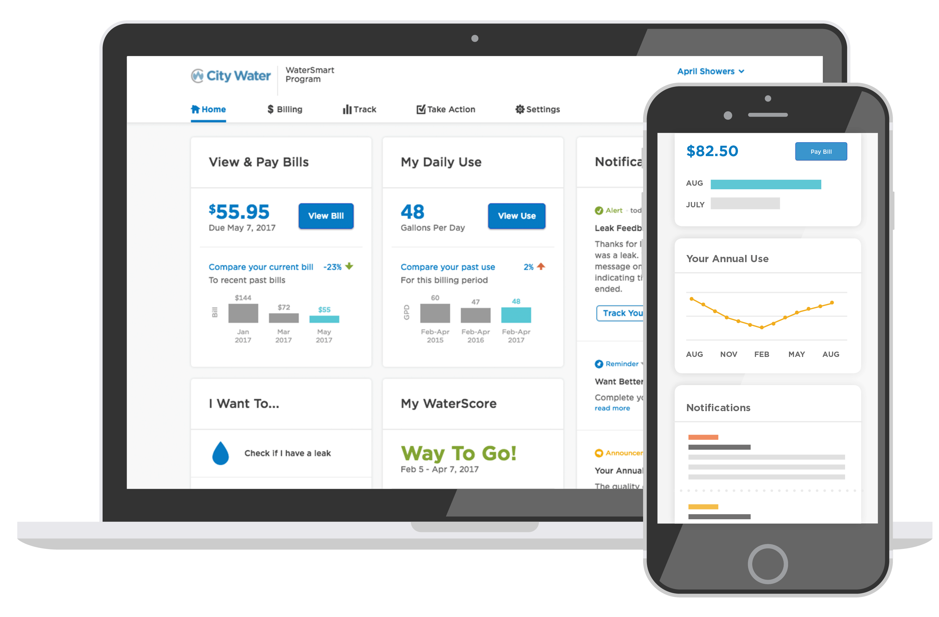
WaterSmart
Direct exposure to data
Automated alerts & notifications
Integration with InvoiceCloud
Streamline customer communications
Monitoring traffic/click counts
Chat function
Image from WaterSmart Software
Notes:
-InvoiceCloud embedded in WaterSmart for single sign-on bill pay and use info, WaterSmart linked to our webpage

Slide 31
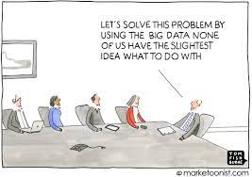
About that data…
Working with TWRI/AgriLife to ask good questions
  Developing questions that our data + GIS data can answer
  Developing questions that yield actionable information for us and for customers
  Developing questions we would not think of on our own
  Answering the questions!
Notes:
It’s a partnership between AgriLife and Engineering :)

Slide 32
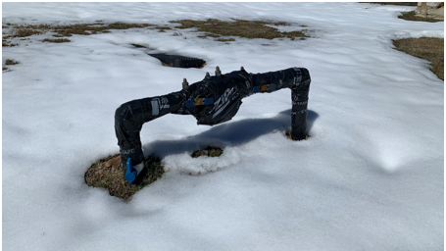
If/Then – Using AMI to Start Conversations
  What were system performance responses like during winter storm Uri?
  What is the impact of developing areas on our distinct supply sources?
  What is the probability homeowners make changes after getting a leak alert?
  Are there correlations home or business characteristics and use?
  Do consumers that view their data actually use less, and if so, by how much?
Notes:
Understanding what our data tells us can help us identify groups of customers or topics that customers will engage with us on
-not just residential, but commercial, developer/builder, schools

Slide 33
Questions?
Chelsea.Hawkins@clwsc.com

Slide 34
Customer Engagement Panel

