Slide 1
Notes:
Introduction

Slide 2
Notes:
We all lived through Uri, a historic winter event for much of Texas. Today I’ll talk about part of SAWS response immediately after as well as long term programs to prepare for future events.

Slide 3
Notes:
In the days that followed the freeze, pipes thawed out and burst for many of our customers, causing emergency leaks that required water to be shutoff asap. This left customers with no water to parts of the home or in many cases completely without water until repairs could be scheduled and completed. Shortage of plumbing repairs due to high demand across the entire state.

Slide 4
Community Pipe Repair Program (CPR)
$1.2 million in donations from business and individuals to the SA Area Foundation
1,183 low-income customers received assistance
Limited Reimbursement
Direct Plumbing Repairs
“Lifeline” assistance program
Plumbers to People blueprint
Notes:
“limited reimbursement-allowed customers to work with other plumbers if they could 1. afford it or 2. could find a plumber available.
Direct-Over 700 customers requested this option due to their limited $ resources
Having existing programs in place that can be utilized for future emergencies, was a huge impact. Initially, we utilized PTP to do emergency shutoffs as we quickly implemented the CPR program

Slide 5
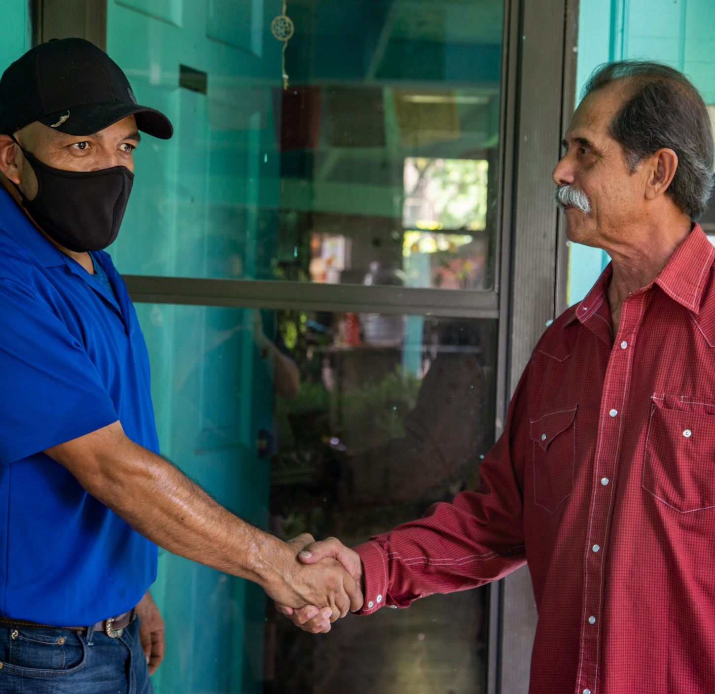
Notes:
The emergency assistance they received, earned the trust of many of our low-income customers (validated with the Be Ready campaign high participation rate and feedback)

Slide 6
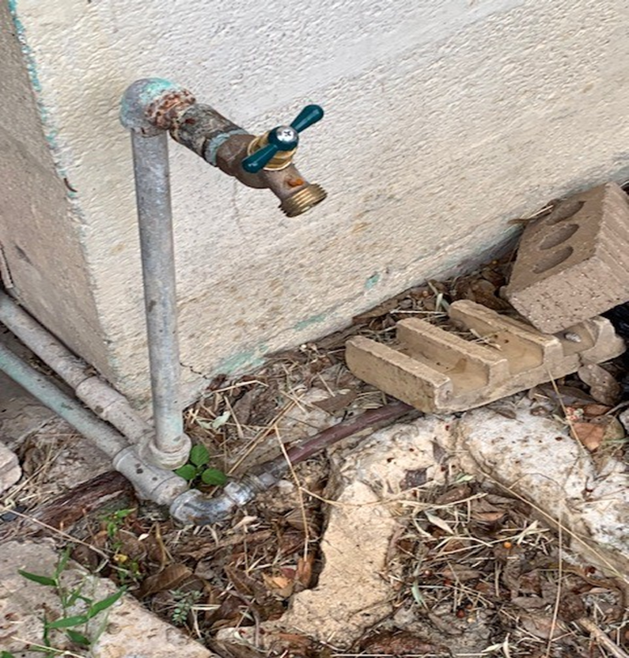
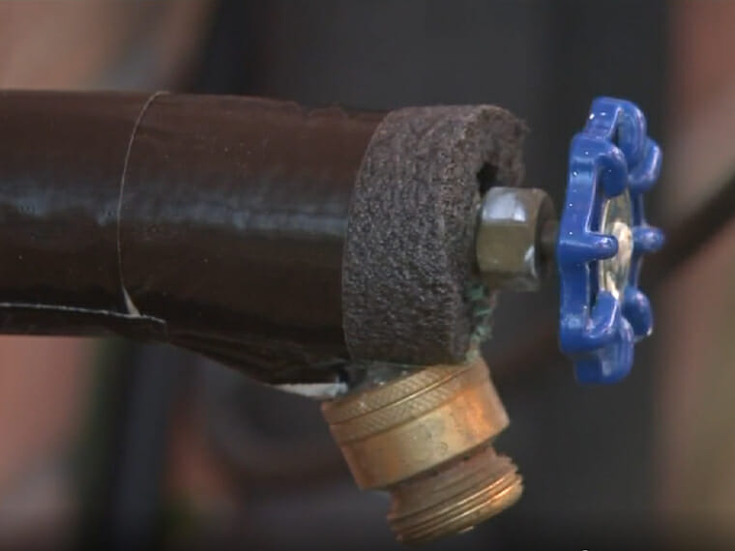
Be Ready: Free Winterization Assessments
Protect vulnerable homes from future freeze events
Insulate all exposed pipes and leak assessment of all plumbing fixtures
Notes:
Lower income customers are more likely to live in older, poorly maintained homes.
The CPR program restored water services for homes but did not address future risks. This effort circled back to ensure that exposed pipe is insulated and that customers have equipment to cover hose bibs. (Sent to 720, Completed 290 = 40%)

Slide 7
Be Ready: Rebate
Winterization & Leak Check
Customers must hire licensed plumber
Complete assessment of freeze risks
Complete leak check
Submit required checklist and plumber invoice for $75 rebate on bill
Notes:
Offered to all SAWS residential customers, included in bill inserts and promoted. Very low participation so far. $$???
Contrast is the difference between the assistance through CPR which paid a substantial amount of or all of expenses to lower income households vs incentives to other households where we intentionally put our incentives at more of a “discount” against total cost.
Why cover so much for lower income? That is what it takes.
Why not for others? Goal is to figure out a cost effect nudge that people see as a good deal or that gets their attention to the issue. If all they do is look at our checklist, think about it and conclude “I can do this myself with no plumber” we still succeed with the nudge…they acted on the issue.
A program design nuance that seems challenging for many ..even conservation professionals.

Slide 8
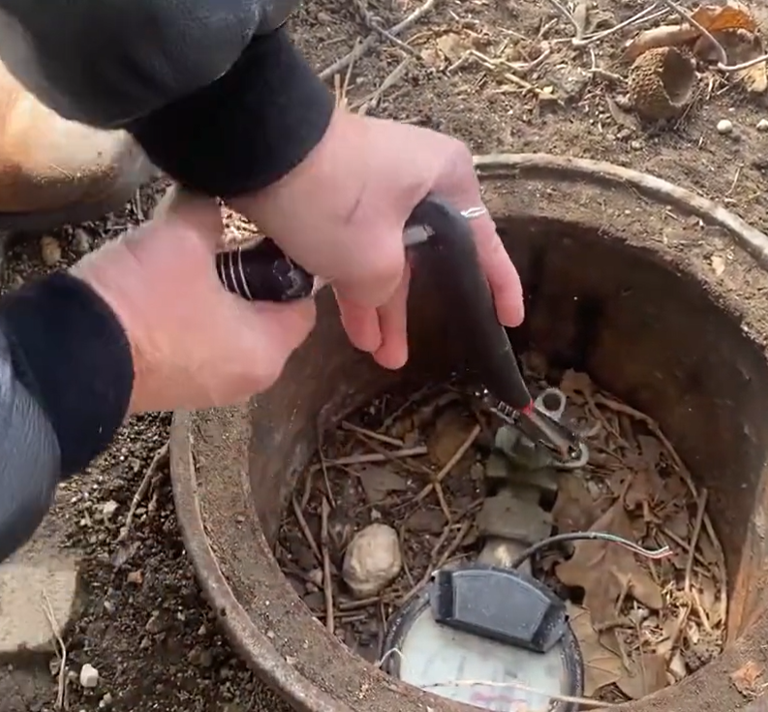
Shut Off Valve Rebate
Notes:
Quickly became apparent that many of our customers don’t have easy way to shut water off when emergency leaks occur. We provided a video of how to turn off at meter but this is very difficult for many customers, and requires customer to potentially damage a SAWS asset, causing an even bigger leak emergency at the SAWS cutoff.
Customers now see the need for a cutoff valve on their side of the SAWS meter but retrofitting can be tricky on older existing service lines (always installed when new service line replaced by our contracted plumber)

